Slide 1













DC Housing Prices
Boot Camp Final Project
Dream_Team

Slide 2

Dream Team Composition and Roles
Diana
PPT and Dashboard
Emmanuel
Database and Machine Learning
Kyle
Dashboard
Sied
Machine Learning

Slide 3
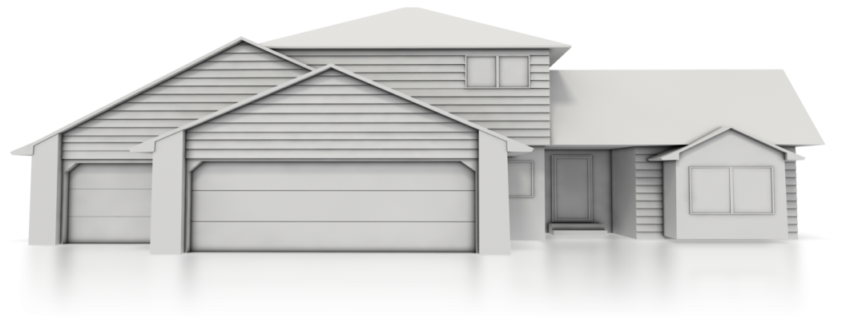
Summary Layout
A second line of text could go here
1
Project Background, Topic and Data Sources
2
Data Exploration, Database , Machine Learning
3
Dashboard
4
Finding,
Questions Answered,
What we would do differently

Slide 4
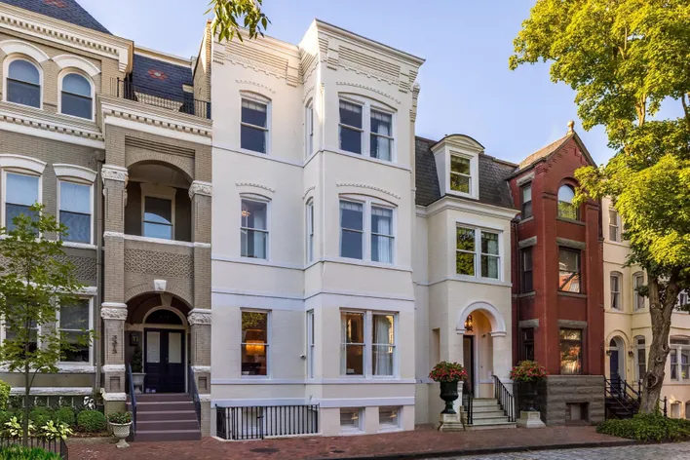
Background
Real estate is a hot market
Interested in seeing how various factors affect the price of a home in DC area
Model can help buyers or sellers to determine if the property they're interested in is accurately priced
Notes:
Gabby

Slide 5





What? Questions We Hope to Answer
Price in future
Are homes in the area being under or over-priced?
.
School Rank
Does the rating of schools affect the home value? If so, how?
Prime Rate
How does Prime Rate affect home value?

Slide 6

Data Sources
Kaggle: Preparing the D.C. Real Property Dataset
SchoolDigger.com: District of Columbia High School Rankings
DC Public Schools : School List
FRED Economic Data: Bank Prime Loan Rate Changes: Historical Dates of Changes and Rates (PRIME)
This Photo by Unknown Author is licensed under CC BY-SA-NC

Slide 7
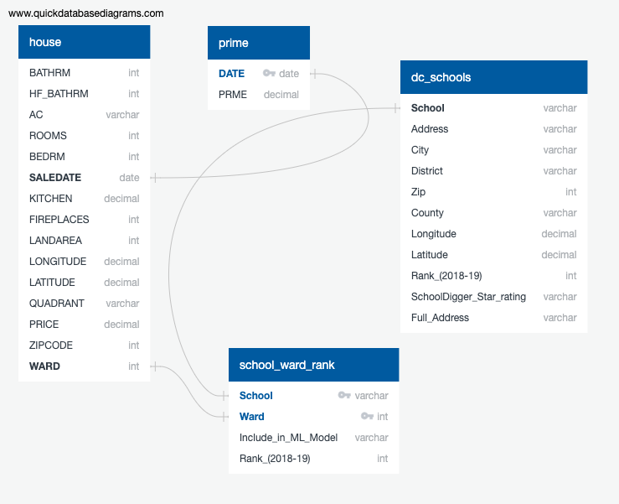
SQL Database- Data points and connections
G
Notes:
Gabby
ERD
Additional cleaning in SQL

Slide 8








Technology Workflow for the project

Slide 9
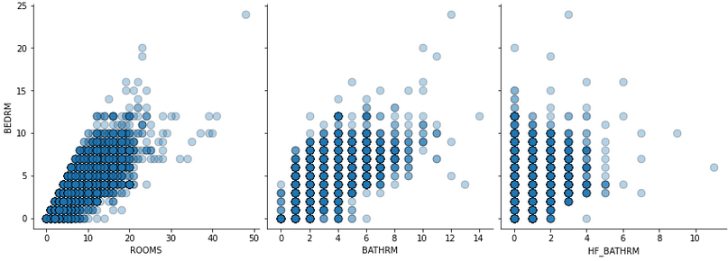
Exploratory Data Analysis
Main Takeaway:
Tools: Jupyter Notebook - Pandas, Matplotlib, Numpy, Seaborn
Loaded Data
Created DataFrame
Explored the Data
Changed Data Types
Visualized Features
Selected features that were most relevant to the analysis
Used visualizations & descriptive statistics. Determined data types, value counts & checked for null values.
Utilized scatterplots to look for any correlations
Many outliers in the dataset
Ex. Homes with 25+ rooms and over 8+ bathrooms
We hypothesized that there were other types of real estate and decided to use Price per Bdr or Price per Room to normalize the data set.
Notes:
Correlations between features
Had to transform many data types
Useless/irrelevant columns

Slide 10
Analysis (Machine Learning)
Attempted Models:
RandomForestRegressor
LinearRegression
Began with simple models (RFR & LR)
Final model we decided on: RandomForestRegressor as it provide better acuracy
Notes:
Francisco
Move some of these details to the lessons learned slide
This slide should focus on the RandomForestRegressor
Overview of the different ML models attempted
Issues encountered
Final model decided on

Slide 11
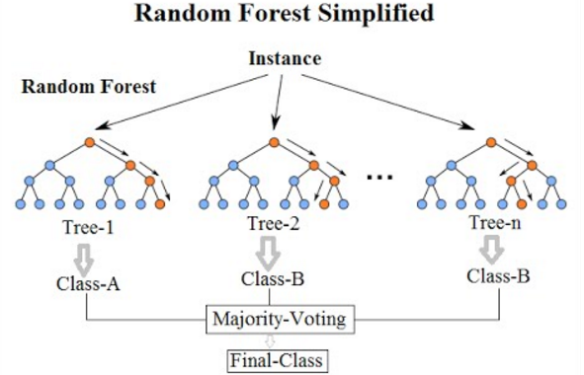
RandomForestRegressor
Function: Input data is passed through multiple trees and it outputs the mean prediction of the individual trees
RFR provides higher accuracy through cross-validation
More trees cushion potential over-fitting
F

Slide 12
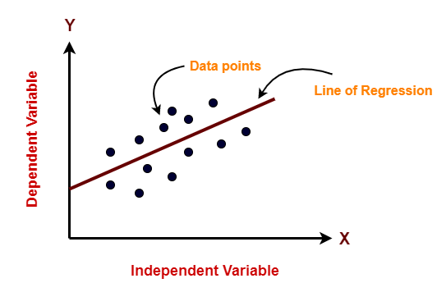
LinearRegression
Function: Predicts a dependent variable target based on the given independent variables
Four assumptions of linear regression: linear relationship, independence, homoscedasticity, normality
Very simple model
Avoid overfitting by using cross-validation
F

Slide 13
Dashboard Demonstration
TBD
D
Notes:
https://public.tableau.com/app/profile/dolores3708/viz/Final_Project_Draft/Story1?publish=yes

Slide 14

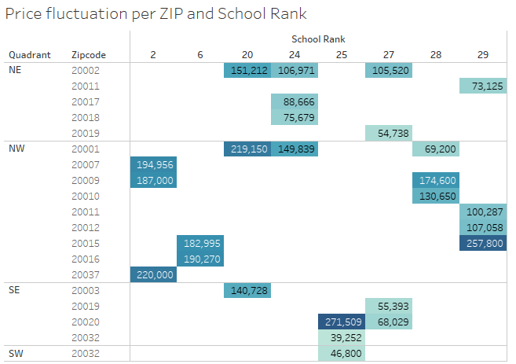
Analysis/Results
Does the rating of schools affect the home price? If so, how?
There is a direct correlation to the Ranking of the school. As seen in this example, within the same Zipcode, the price per Bdr across 3bdr options varies by 30% between high and lower-ranked school
D
Notes:
Dolores
Need link to dashboard for demonstration?
Answer: Yes, we can see that homes with a higher average price are located near schools with a higher rank

Slide 15

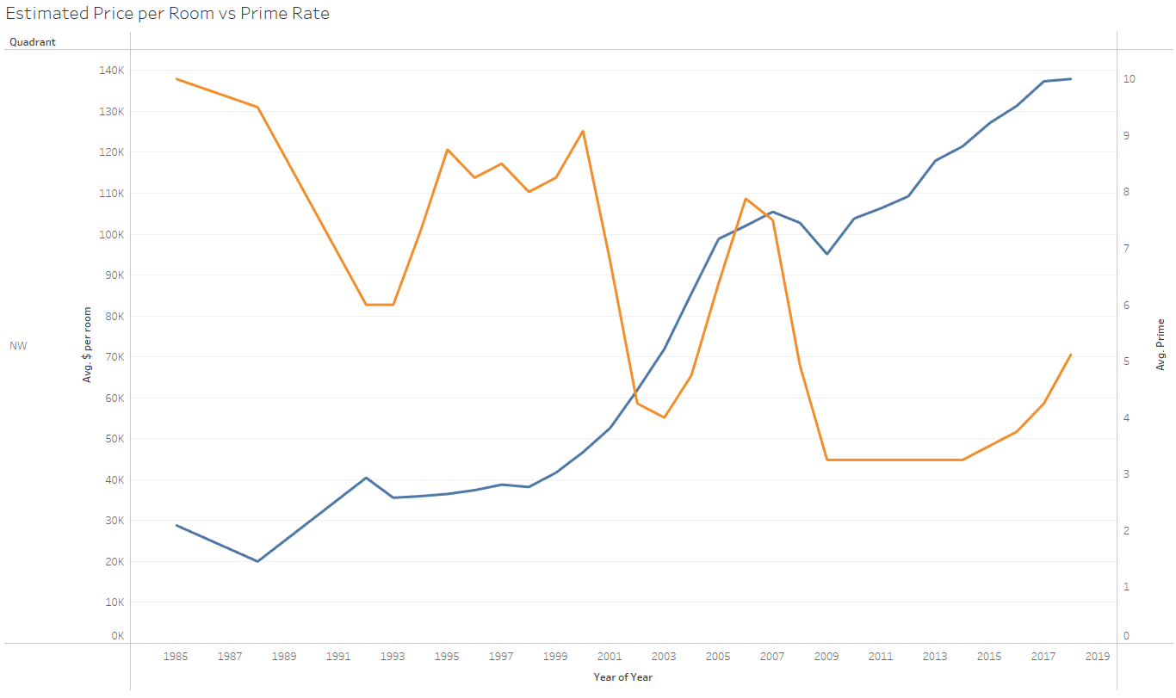
Analysis/Results
2. How does Prime Rate affect home price?
Over a 30-plus year horizon, we do see a negative relation between Price per room and Prime rate difference. However, in the past 10 years, that correlation is less vivid. It looks like depending on the location and size of the house, the impact of Prime Rate is variable.
D
Notes:
Dolores
Answer: As Prime Rate has decreased over the years, average home price has increased. This reflects how banks have had to lower interest rates in order for people to purchase homes?

Slide 16
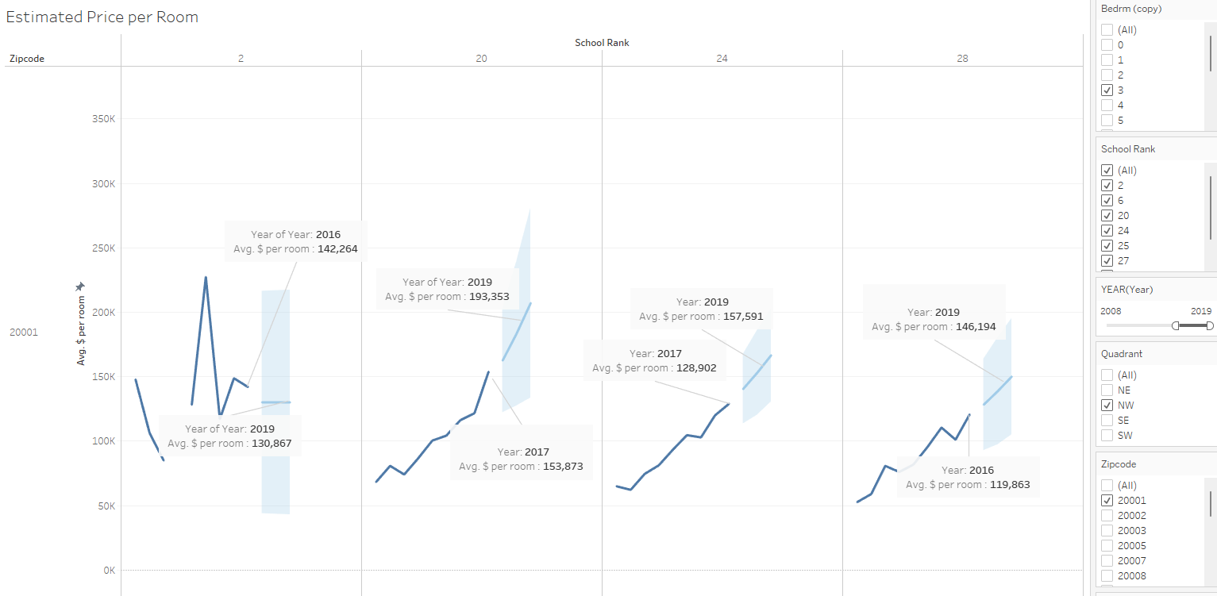
Analysis/Results
3. Are homes in the area being under- or over-priced?
The project would be for home buyers/sallers to determine if the home they are looking to purchase is above or below avg price for this location, size, and school proximity.
It is important to note that this model does not take into account Year build, Sq, Condition, etc
Notes:
Francisco

Slide 17
Recommendation for Future Exploration
How does crime affect home prices in specific areas?
How does the proximity to public transportation affect home prices?
How does the presence and distance to hospitals affect home prices?
D
Notes:
Dolores
Future development of ML model where we build a website where users can input the criteria for their home & learn if it’s being over or undervalued

Slide 18
What Would We Do Differently?
Finding Data
Exploring other data sources early on (relied heavily on Kaggle)
Not settling for a dataset
ML Model
Attempt other models i.e. Lasso Regression
If a larger dataset was found, attempt a Neural Network
F
Notes:
Francisco

Slide 19

Questions? Comments?

